Slide 1

Information Retrieval Course Project
Scraper

Slide 2
Introduction
This project takes an amazon link (in our case shoes link) and then our amazon spider starts to extract the data we want from the page (shoe’s name, brand’s name, shoe’s price and finally shoe’s image link) and then download these images locally to a folder of your choice.
We will discuss how this works in detail and what tools we used to achieve that purpose.

Slide 3
Tools And Modules
PyCharm IDEA
Python 3
Scrapy (free and open-source web-crawling framework written in Python)
Requests (we use this module to send requests to servers to download images)

Slide 4
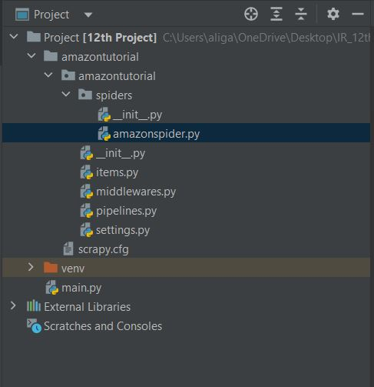
Project Structure
Once We install Scrapy it adds some files automatically to the project file.
In our project we used:
Items.py (where we yield our data to it)
Settings.py (where we change User_Agent ‘domain name’ and we will explain why later).
Finally our main spider code is at amazonspider.py

Slide 5
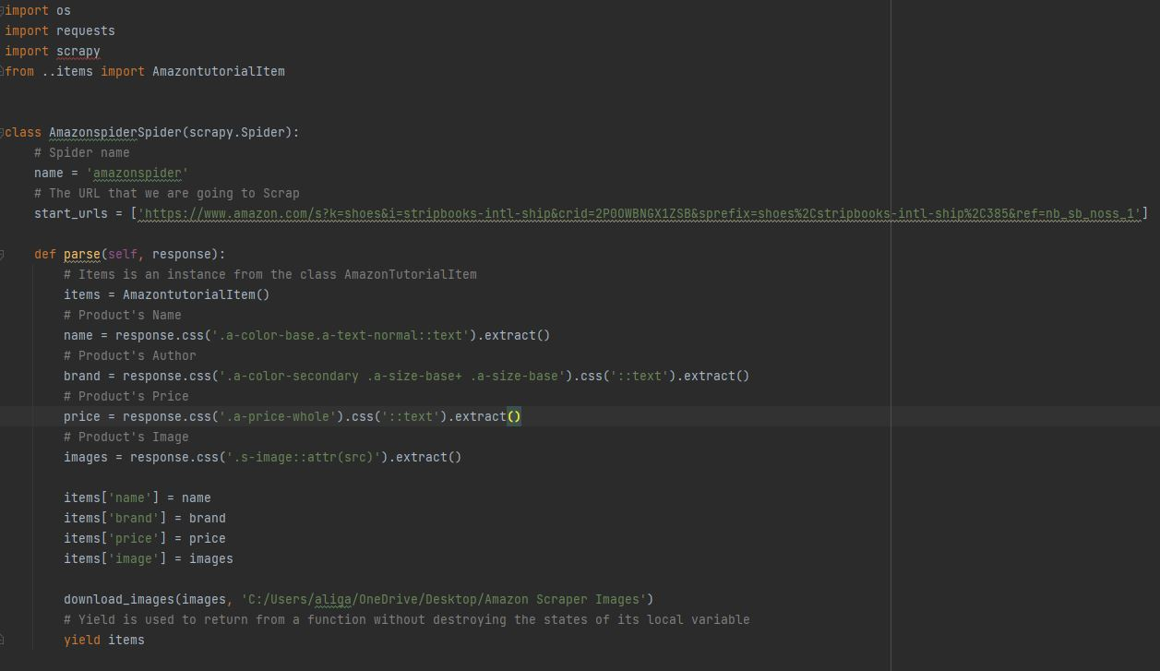
Code Explanation
Imported Modules and Class Amazon Items from class items
When we call a spider function parse is called and then we have to get manually the name of the elements we want to get from the website, since there are thousands of elements in each page.
Class Amazon Spider where we name our crawler and put the URL we want to Scrap
Finally we call a function “download_images” and pass images urls we extracted and the folder location we want to download the images in.
Here we assign the fields in our Amazon item class the values we extracted in case we wanted to use them later.

Slide 6
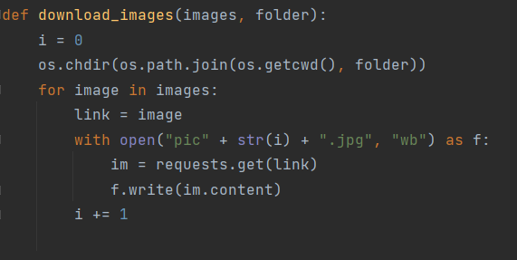
Code Explanation (Cont.)
Function download_image as we said earlier it takes 2 parameters; images list and folder name.
We have i = 0 and we use it in naming our images
We os.chdir changes the directory to the folder I want to save the images to.
Finally we iterate throw the list and send request to all the urls and then write the content reseved to the folder.

Slide 7
Change Domain Name
As we learned before, crawlers are headache to the server administrators because they may cause the server to not be able to serve other users duo to crawlers fast and continuous requests. ( They kind of work like a DoS attacks)
So, Server administrators block or even ban the domain that spam them with request in inhumanly way (crawlers).
To avoid that we can use different domain every time by using VPN or as we used here Googlebot.
To do that we can change USER_AGENT in settings.py file which where provided by Scrapy module.

Slide 8
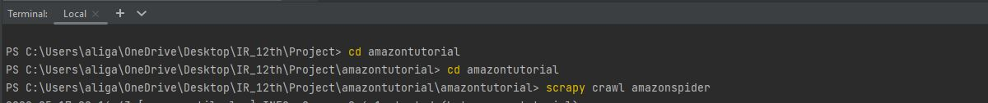
Running Scrapy
In order to run scrapy you need to get into the directory of the spider.py file first, then simply type in the terminal: scrapy crawl “your spider file name” in our case amazonspider.

Slide 9
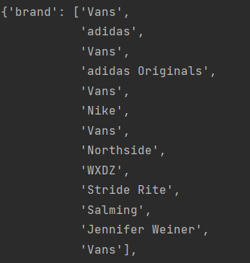
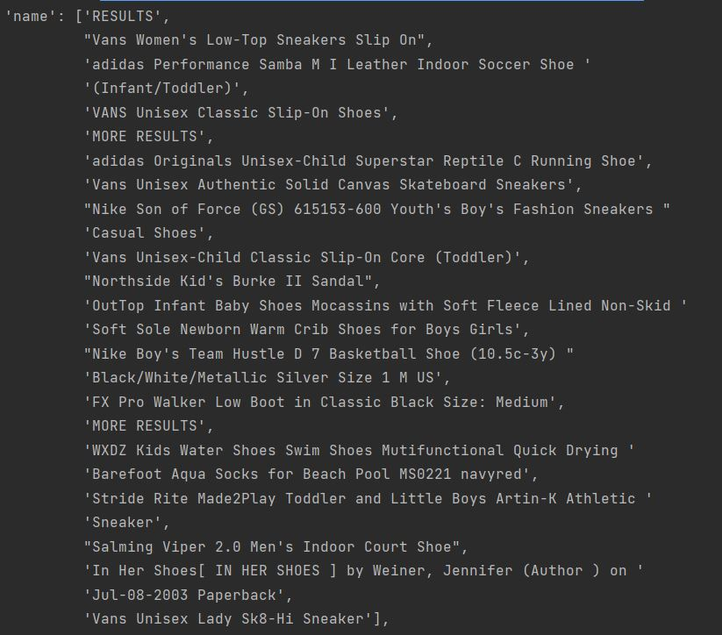
Output
shoes brands
Shoes names

Slide 10
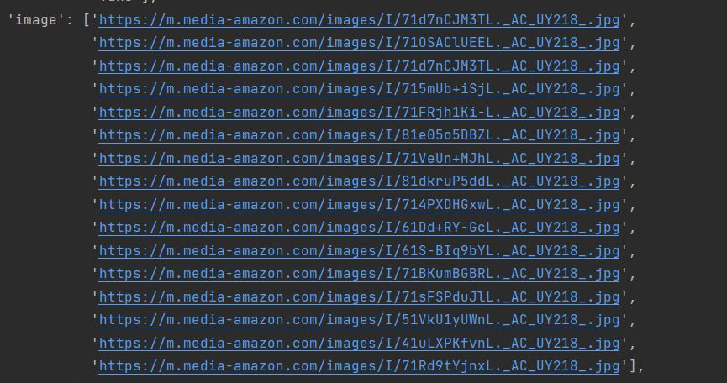
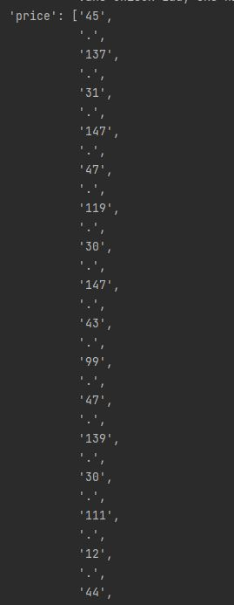
Output (Cont.)
Shoes Image URL
Shoes prices

Slide 11
Thank You!

